Slide 1
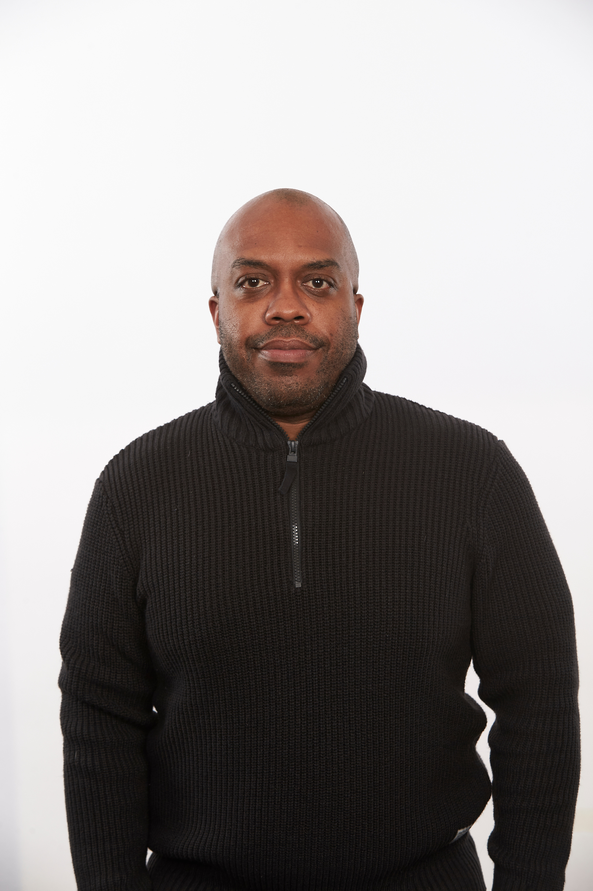
Nathan Hunt
Club Environment
Sporting Kansas City Director of Coaching, Academy Affiliates (2019-2022)
KSYSA Director of Coaching (2016-2019)
President/Technical Director, Arkansas Rush (2012-2016)
Bachelors of Arts – Economics (University of Kansas)
United States Soccer Federation
Technical Lead B Course and Coaching Training Sessions Learning Lines (September 2023-Current)
Technical Lead Grassroots and D Course (October 2022-September 2023)
DOC License Educator
B License Educator
C License Educator
Grassroots Instructor License Educator Level 1 and 2
National Staff Instructor
USSF A License

